Slide 1
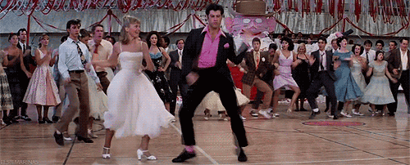
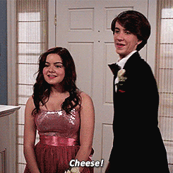
What do they want to wear
to the prom?

Slide 2
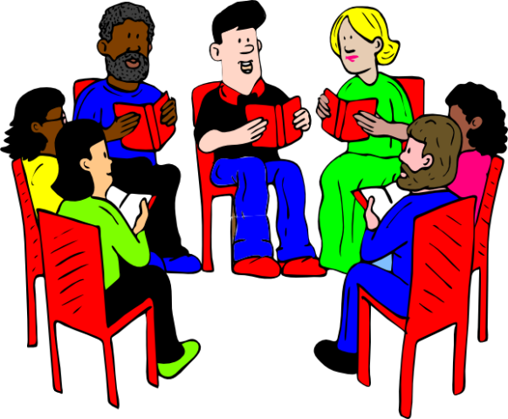
Everybody reads the dialogue together.

Slide 3
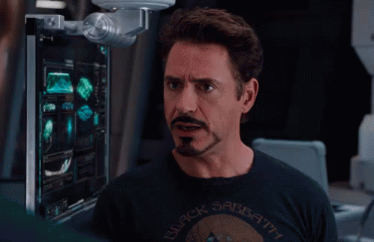
Draw and Guess

Slide 4
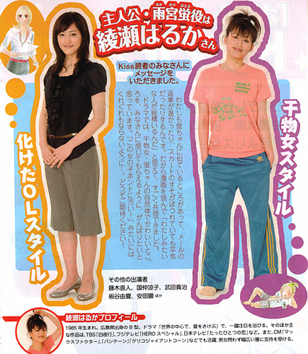
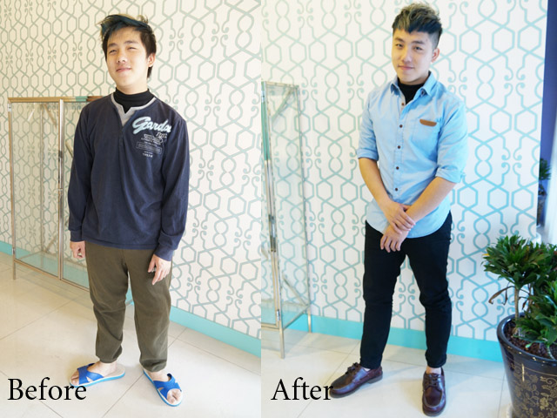
Clothes make the man.
人要衣裝

Slide 5
Phonics Time

Slide 6
short oo sound

Slide 8
oo
f
t

Slide 9
oo
b
k

Slide 10
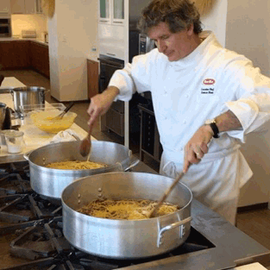
oo
c
k

Slide 11
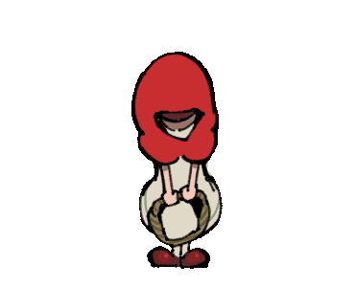
oo
h
d

Slide 12
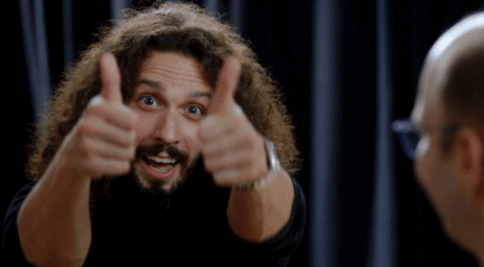
g
oo
d

Slide 13
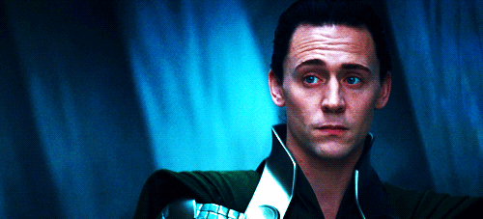
l
oo
k

Slide 14
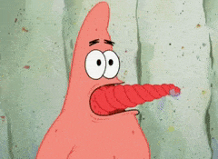
Let’s twist our tongues!

Slide 15
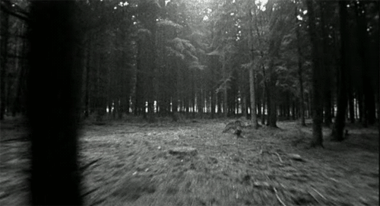
The cook is reading a book in the woods.

Slide 16
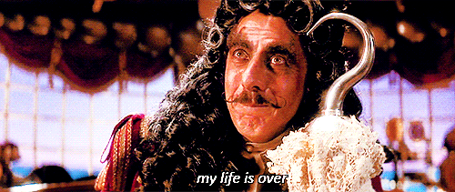
Kelly is a cook.
She goes to work on foot.
Here is Kelly’s hood.
She hangs it on the hook.

Slide 19
Let’s stick up your RT script!
501:pink
502:purple
503:green
504: blue
505: yellow
彩色紙對折
Long ago那一頁在左邊
上下對齊
小心貼上
稿子最上面寫班級座號姓名
用螢光筆畫好自己的台詞
封面不可做任何裝飾

